Slide 1

History of one Frankenstein
Nikolay
Eckert

Slide 2

App Store
Simply
PWA
To in browser…
Light access!
Easy
Plainly
Play Market
Offline

Slide 3

One codebase

Slide 4



Slide 5


Slide 6


Slide 7
Progressive Web Applications
Technology
Target
Service Worker
Web App Manifest
HTTPS
App Shell
Push Notifications
Reliable
Fast
Engaging

Slide 8
Progressive
Web
Application
Reliable — Application is loaded and immediately show outside depends of status and quality network connection.
Fast — data interchange on the network quickly happens. UI smooth and user fiendly.
Engaging — creating the good user experience on used the application. The urge to return to the application.

Slide 9


Slide 10



General stack technologies

Slide 11
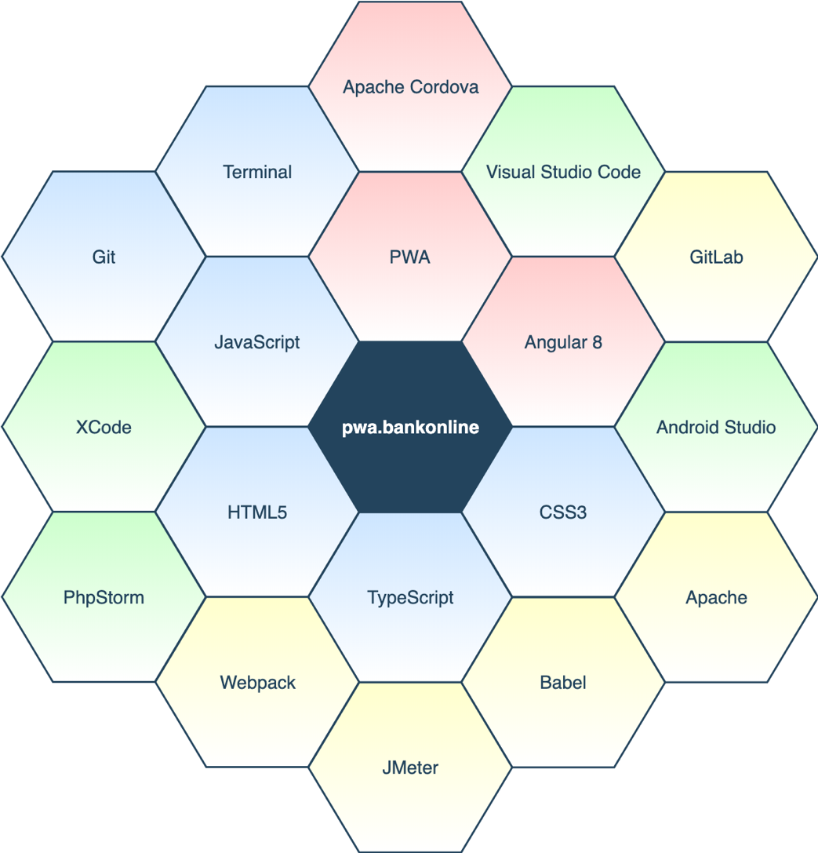
Full stack technologies

Slide 12
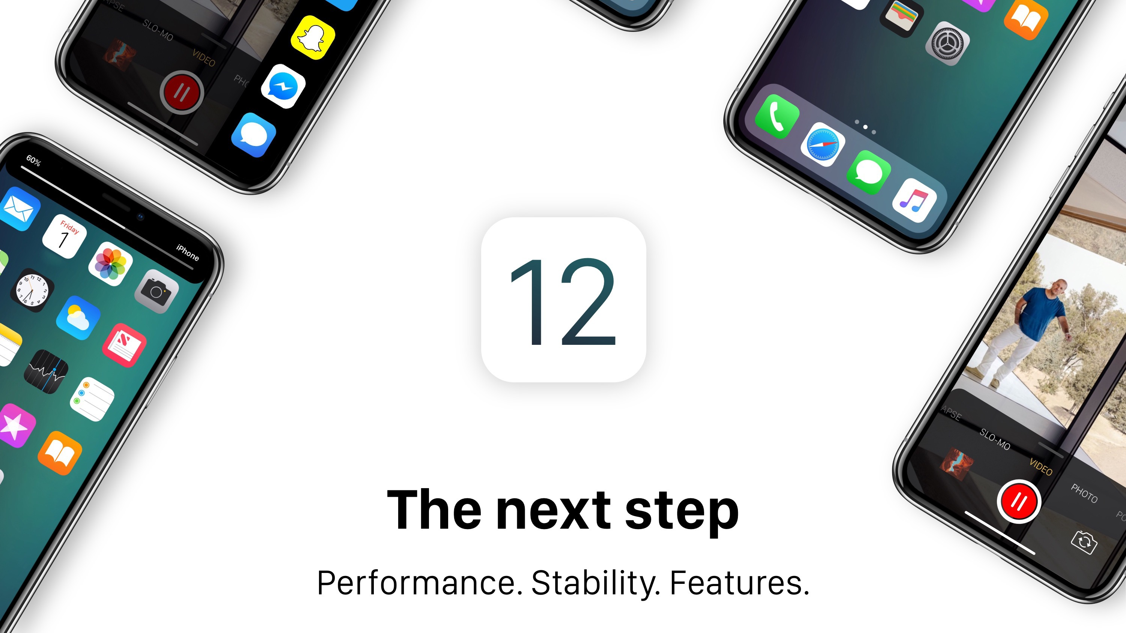

Slide 13
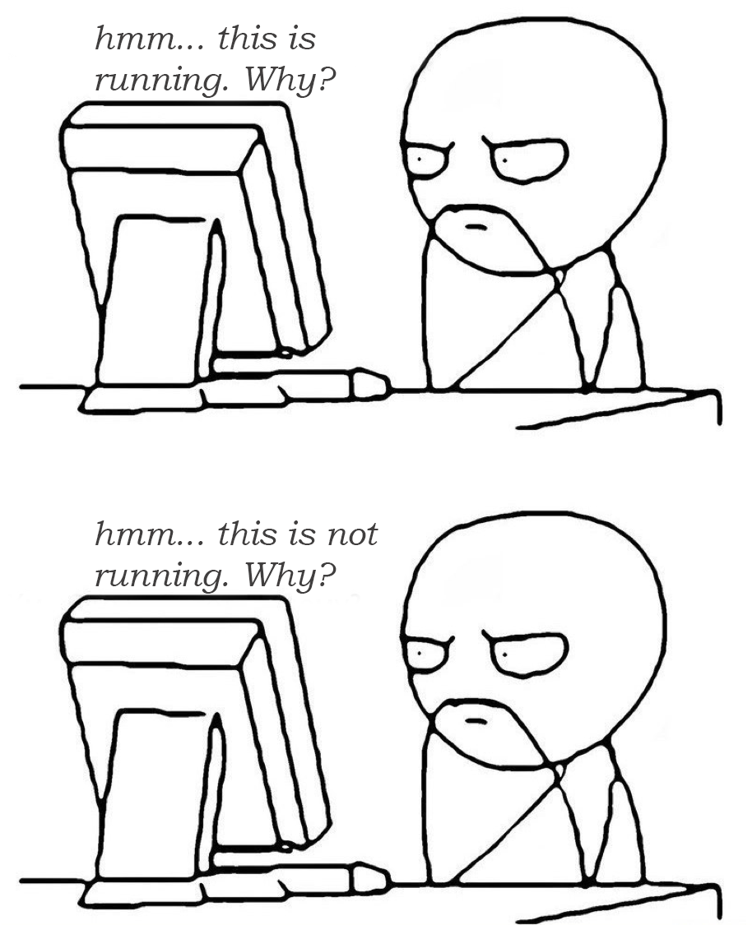

Slide 14

The third bug run

Slide 15


Slide 16


Slide 17
Release.

